Slide 1
Kindergarten RLA Do Nows
May 4 - 8, 2020

Slide 2
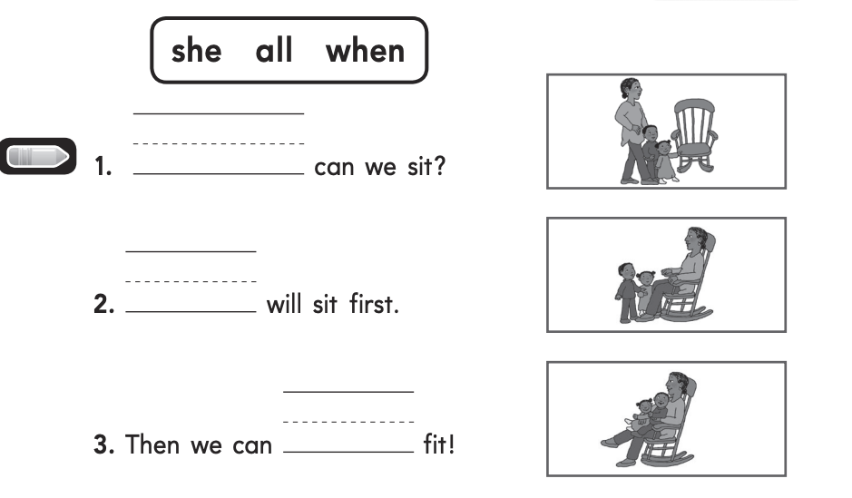
M D No O
Monday’s Do Now
.

Slide 3
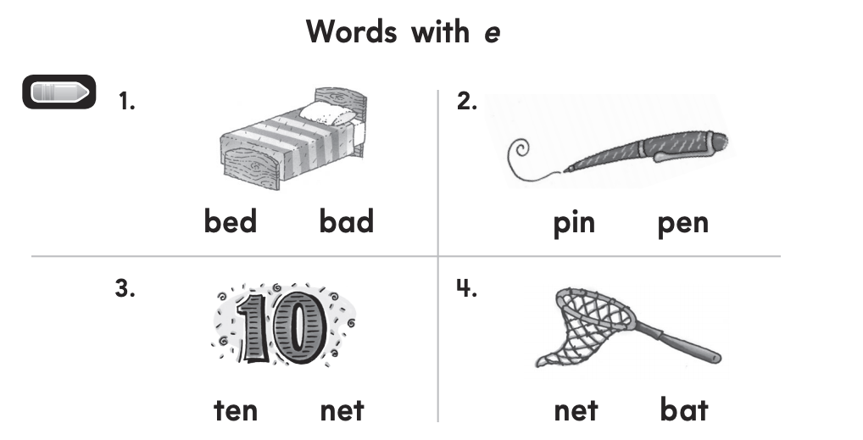
Tuesday’s Do Now
Circle the correct word for each picture.

Slide 4
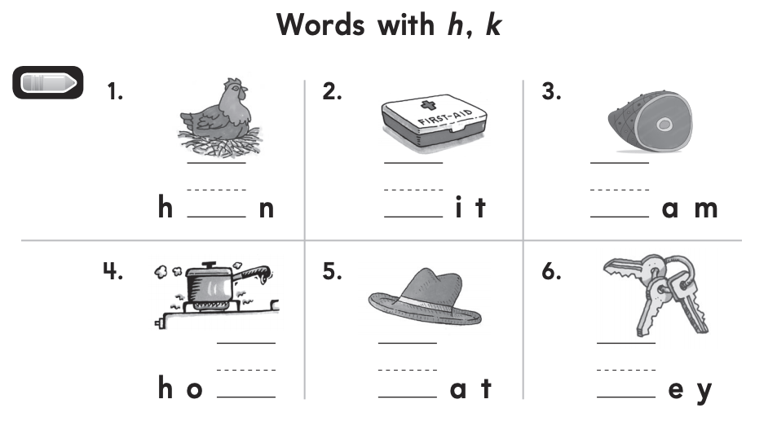
a. Dad is angry. b. Bob nToddChooseeed to clean his messy room. c. Toy trucks are on Bob's floor. d. Bob was not happy. M D No O
Wednesday’s Do Now
.

Slide 5
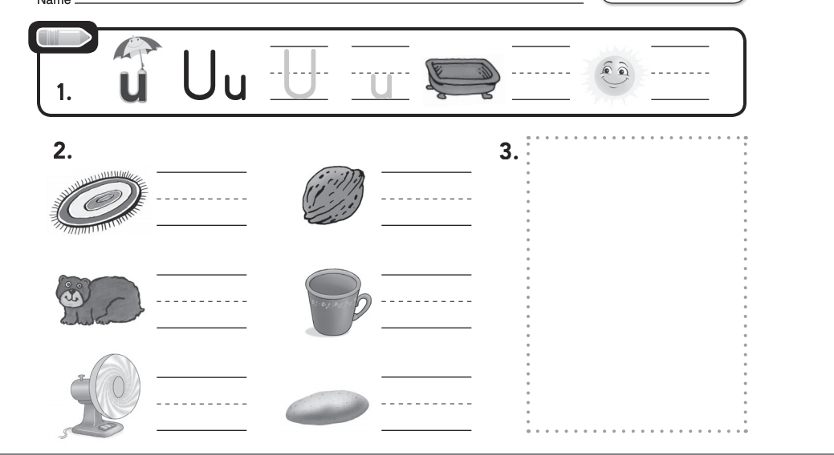
M D No O
Thursday’s Do Now
Choose the pictures whose middle sound is short u.
.

Slide 6
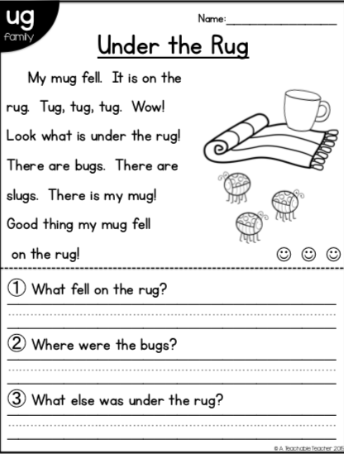
Friday’s Do Now

